Slide 1
Topology Modeling experience at Telefonica
Expericences from the iFusion project
O. Gonzalez de Dios (Telefonica)
Side Meeting on digital map 8th November 2023, Prague IETF#118

Slide 2
What do we want to achieve?
Goal of iFusion: offer a yang-based representation of Telefonica networks, based on layers, complemented by a live inventory view, a collection of the most common Telefonica services and streaming telemetry.
Consumers:
Planning tool performing capacity planning, what if scenario…
Visualization tools
Service orchestrator
Inventory (where conciliation vs planned network is done)
Multiple OSS tools
Premises
Use IETF Yang models as the modelling base
Methodology
Design and implement use case by use

Slide 3

Overall view of the models
The Yang models are interconnected, allowing to navigate
Base topology model
INVENTORY MODEL
TRAFFIC ENGINEERING AND PATH COMPUTATION
L2 Topology
L3 Topology
TE Topology
HW Inventory
logical Inventory
IS-IS
Topology
OSPF opology
Services
TE
Infrastructure base services
<augment>
Peering Service
L3NM
(L3 VPNs)
L2NM
(PW, L2 VNPs..)
Service Mapping
TE Tunnel
ACL
Routing policies

Slide 4
Topology for planning Use case
This use case aims at providing the Layer 3 IGP topology information to Network Planning and Visualization tools in a structured manner via NBI of the IP/MPLS SDN Controller using standard IETF representation.
Network scenario: IP/MPLS network in which every router participates in one or more IGP processes.
The scope is:
Networks with only IS-IS for some OBs (current and target scenario)
Networks with mixed IS-IS and OSPF domains.
Some routers participate in two or more domains
Legacy design inter-AS links are being removed
This use case does not consider nodes or links that do not participate in an IGP (e.g. access nodes, CE nodes, etc)

Slide 5
Design principles
Based on current RFC 8345 premises
One base layer 3 network
One network per domain
Networks interconnected via supporting node
One base layer 2 network with L2 links and LAGS
Limitations:
No inter-domain links
No relationships between networks
Te tunnels that become adjacencies in the IGP (circular dependencies between layers)

Slide 6
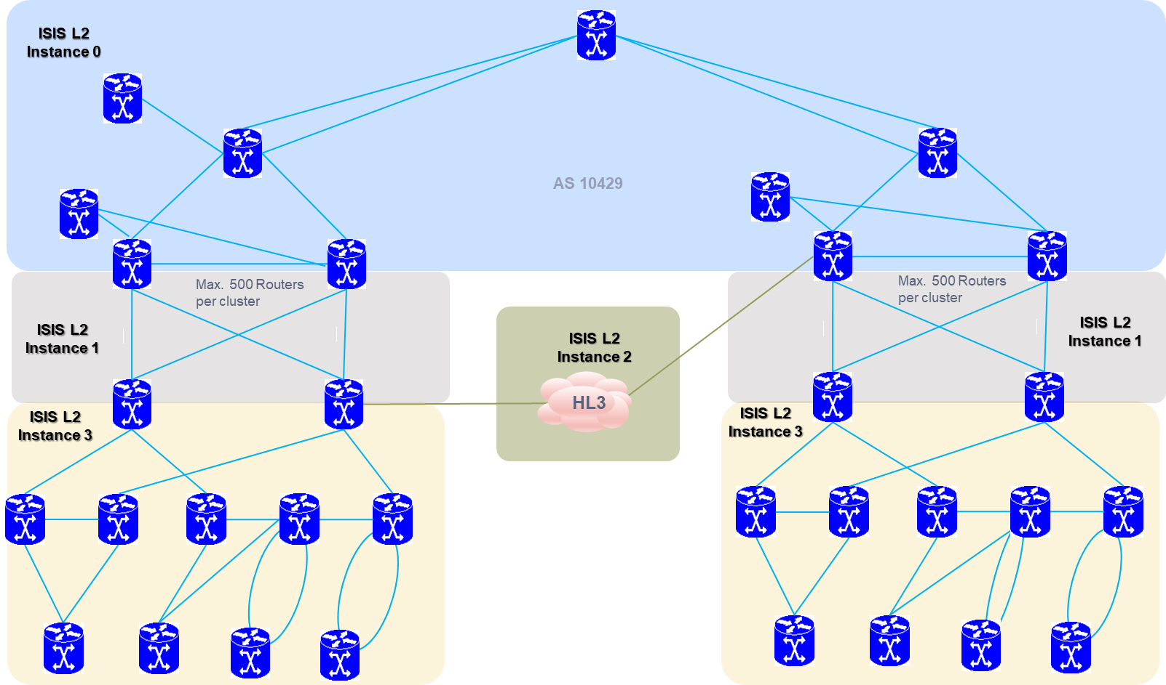
Sample network to model

Slide 7
Base Layer 3 network
Base layer 3 network
This network instance will contain all the IP nodes and all the IP interfaces in the network (as termination points inside the nodes).
This network will not contain links.
The network-types property include ietf-l3-unicast-topology:l3-unicast-topology, and NOT include any IGP related type like ietf-l3-isis-topology:isis-topology. This is the form to distinguish the base layer 3 topology from the IGP topologies.
The supporting-network property is used to link to the lower layer topology (flat physical topology with the layer 2 links, including LAGs)
Base layer 3 network: nodes
Each IP/MPLS router (speaking layer 3) in the network that is part of at least one IGP MUST be part of this network
(node-id) Unique node-id. No hard requirement, but, to facilate visualization, the ne-id used in the controller and inventory is used to refer to the node.
(l3-node-attributes.name) Name: The configured name in the device.
(l3-node-attributes.router-id): Router-id as configured in the device (and adverstised by BGP-LS).
List of termination points: the IP interfaces that have a link in at least one IGP. Othe links were not yet modeled.
Termination point ID (tp-id). It is the name of the interface/subinterface configured.
Supporting termination point (supporting-termination-point). A layer 3 termination point refers to a logical concept, configured in the routers, and typically with an assigned IP address (but in unnumbered IP interfaces). The supporting termination point MUST be the termination point in the layer-2 network (e.g. a hardware Ethernet port).
IP address (ip-address). Each layer3 termination point can have one IP address (normal case), or none (unnumbered interfaces).

Slide 8
IGP network
An IGP domain in iFusion is defined as the collection of nodes and links that participate in the same IGP process.
E.g nodes and links that are announced with the same combination of AS number / Instance ID belong to the same domain.
If a node and/or layer termination point present in the base layer 3 topology, participates in more than one IGP it will be present in multiple IGP domain networks.
The ietf-network instance includes as network-types property:
l3t:l3-unicast-topology (IP packets are routable)
In ISIS case, isisnt:isis-topology
In OSPF case, ospfnt:ospf-topology
To include the bandwidth, delay information and color, tet:te-topology
To include delay and bandwdith performance measurements , tet-pkt:te-packet under the previous property
Nodes are links are included
Links contain IGP specific information AND Traffic engineering related information

